Slide 1
Spam SMS Detection Project

Slide 2
Problem Statement
To detect spam SMS.
The data for this project was obtained from the Grumbletext Web site. This is a UK forum in which cell phone users make public claims about SMS spam messages.

Slide 3
Background
Today, spam has become a big internet issue and in recent times, it has been proven through statistics that spam has accounted more than 60% of all SMS movement.
Data science can play a key role in this domain by helping user distinguish spam SMS from ham SMS with the help of Machine Learning model classifier.

Slide 4
Data Analysis
We get insight of the dataset by determining the shape of data and finding the data type.
Later we perform null value analysis to detect any missing data. Since there were no null values detected in our dataset, we move to next step.
We then encode the categorical target feature.
Using visualization techniques we perform univariate, bivariate analysis.

Slide 5
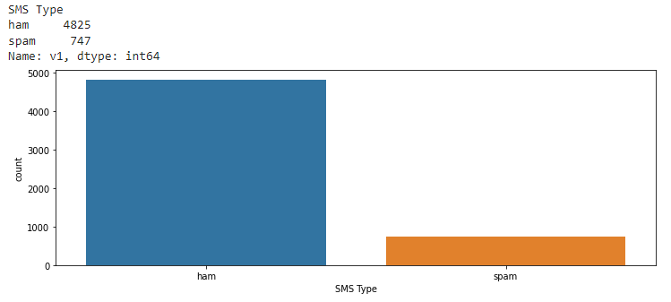
Types of SMS
There are two categories of SMS, first is ham or non spam SMS and second is spam SMS

Slide 6
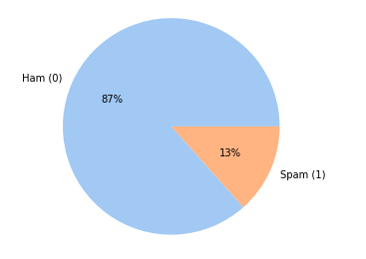
Distribution of ham and spam SMS in dataset
87% of the SMS from the dataset are ham while remaining
13% are found to be spam.

Slide 7
Data Cleaning Procedure
Perform html parsing using beautiful soup, to scrap the text between html tags.
Next, we remove https and .com links from the text and then then split the text to convert it into lower case.
Then we remove all the numbers from the string and using regular expression sets, strip everything other than word and whitespace (like brackets, symbols etc)
Later we eliminate the stopwords and punctuations from the text.

Slide 8
We perform Lemmatization i.e. converting the word to its meaningful base form by looking at its context.
Since overstemming and understemming are two problems that can arise in stemming. For example, the word “fishing” might be overstemmed to “fishin,”.Hence lemmatization text preprocessing which has higher accuracy is preferred over stemming.
Remove any single character, if remaining in the text.
Lastly drop rows with empty strings.
After data cleaning we perform more visualization.

Slide 9
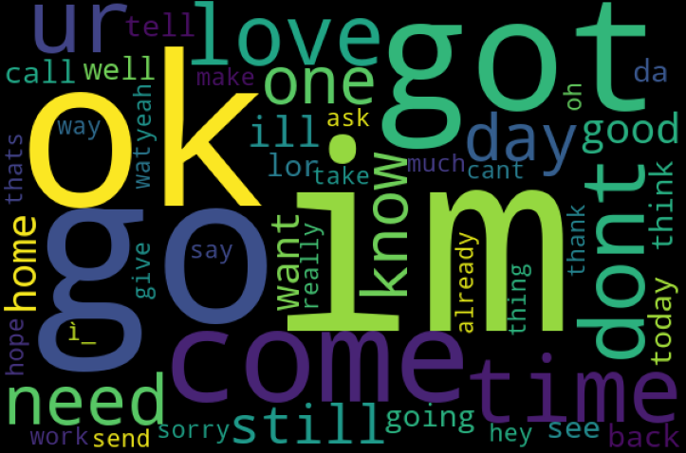
World Cloud (Ham SMS)

Slide 10
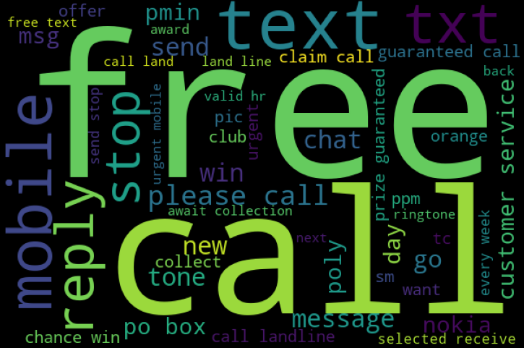
World Cloud (Spam SMS)

Slide 11
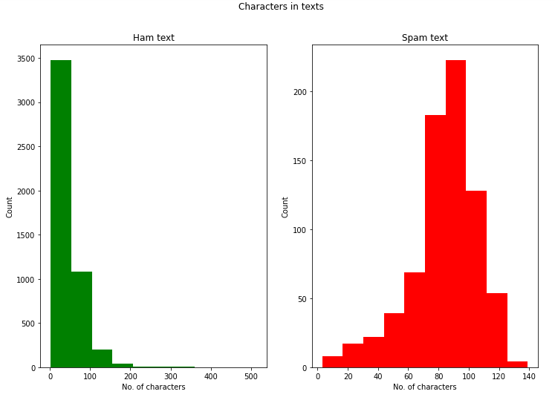
Character Count in Text
Approx. 70 characters in text is most common in ham SMS category while approx 90 characters in text is most common in spam SMS category

Slide 12
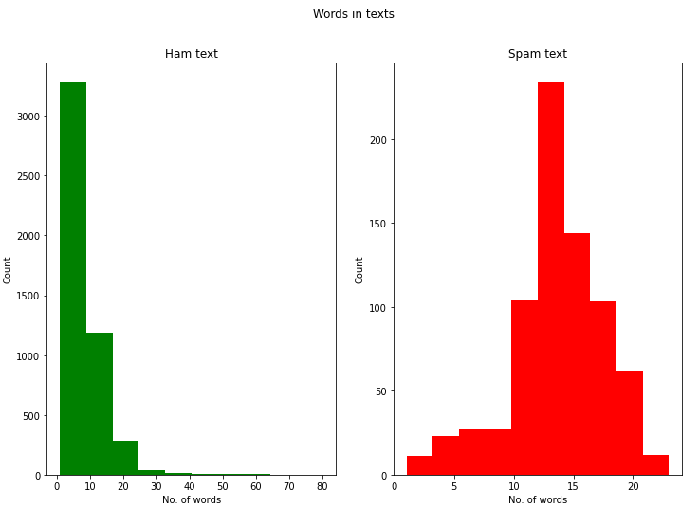
Word Count in Text
Approx. 10 words in text is most common in ham SMS category
while approx 15 words in text is most common in spam SMS category.

Slide 13
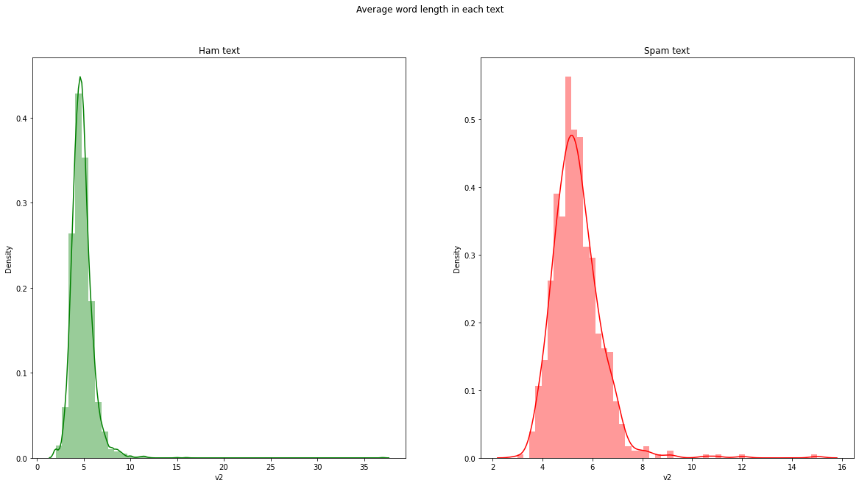
Average Length of Text
The average word length distribution in ham SMS is marginally less than spam SMS.

Slide 14
Next we perform unigram, bigram and trigram analysis.
After computing word counts using ‘CountVectorizer’ we then compute the IDF values followed by Tf-IDF scores.
After that process is complete, we feed the Tf-IDF vectorizer data into the machine learning model for testing.
Then we select and save the best working model based on the results obtained.

Slide 15
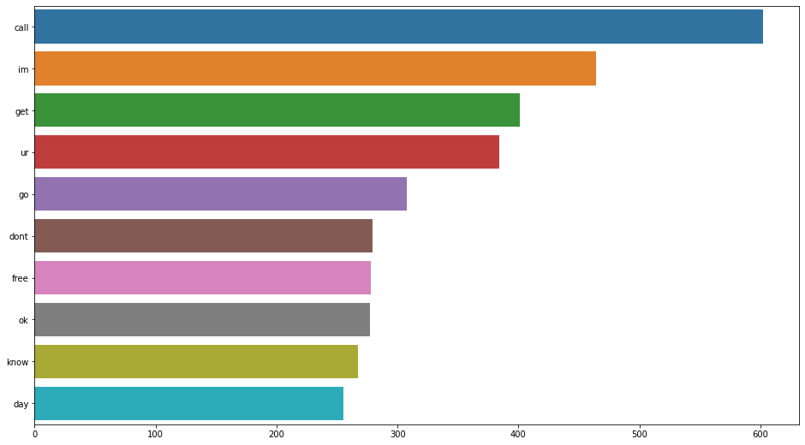
Unigram Analysis
Call is the most repeated word in entire dataset text.

Slide 16
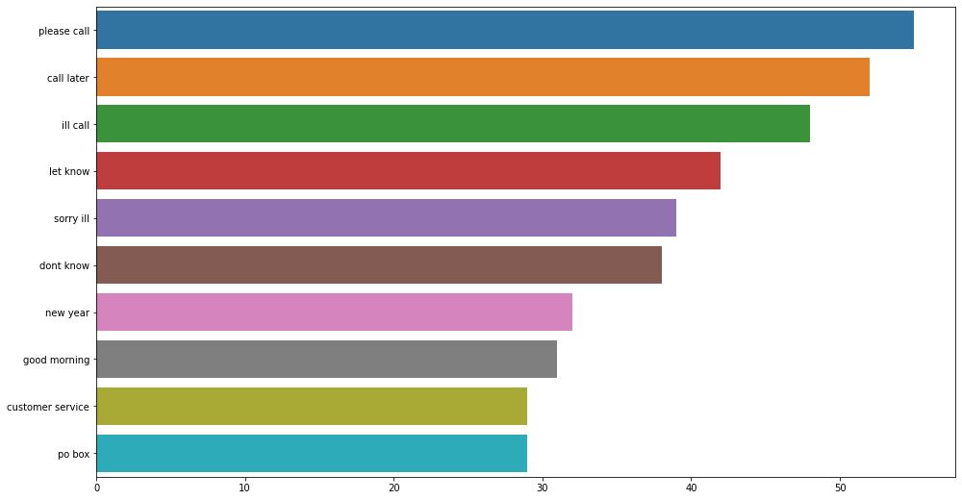
Bigram Analysis
Please call is the most repeated bigram in entire dataset text.

Slide 17
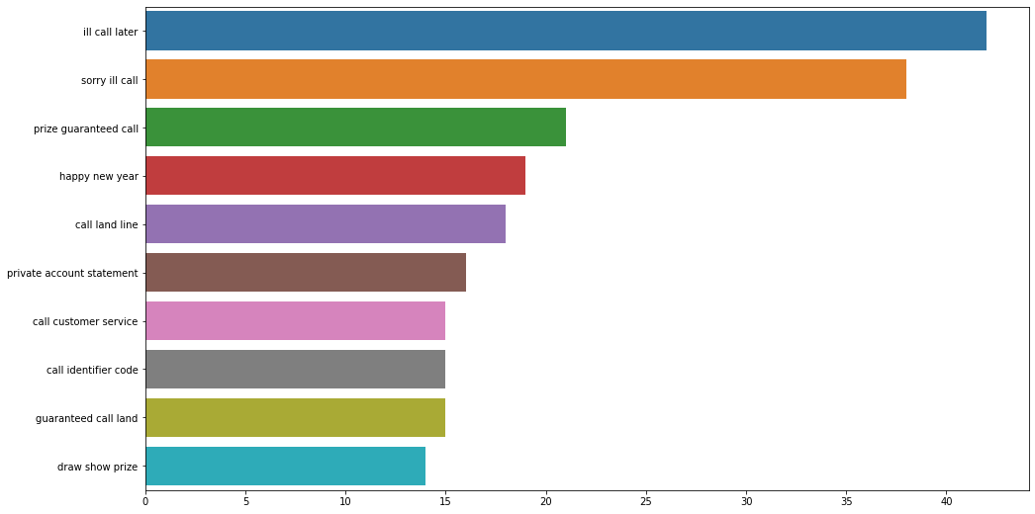
Trigram Analysis
ill Call Later is the most repeated trigram in entire dataset text.

Slide 18
Conclusion
In this study we found that support vector classifier performs slightly better than other classifiers and rest of the algorithm tested.
Call is the most repeated word in entire dataset.
Average word count and character count in spam SMS is more than ham SMS
Hence we were successfully able to detect the spam SMS with high accuracy (97.39 %) and minimum error (log loss of 0.08).

